Slide 1


Year 2020-21
Year 2020-21
Digital Communication
E-Laboratory and practicals
B.Tech. II (CSE), semester –III
By
Prof. Naresh B. Kanirkar
Prof. Mehul C. Patel Assisted by
Arpan Shah
Department of Electronics Engineering
Sardar Vallabhbhai National Institute of Technology, Ichchhanath, Surat-395 007, Gujarat

Slide 2
Experiment no. - 09
Objective- 16 QAM Modulation and Demodulation technique with constellation diagram and waveforms

Slide 3
WHAT IS QAM ?
Quadrature amplitude modulation or QAM is a form of modulation which is widely used for modulating data signals onto a carrier used for radio communications.
QAM is a signal in which two carriers shifted in phase by 90° are modulated & the resultant output consists of both amplitude & phase variations.
Hence it may also be considered as a mixture of amplitude and phase modulation. QAM is both an analog and digital modulation technique.

Slide 5
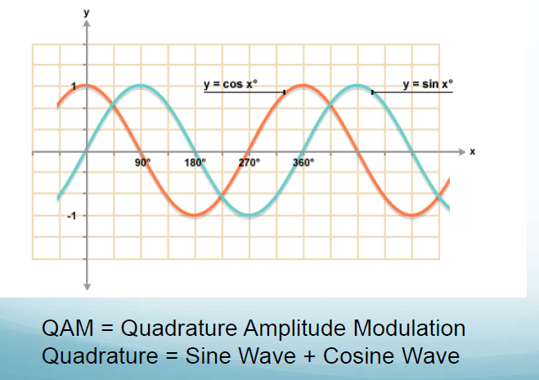

Slide 6
Main Parameters to be considered while designing any communication system
Transmission Power.
Transmission Bandwidth.
Although the SSBSC systems are most power and bandwidth efficient but still their performance lags in the noisy environment.

Slide 7
WHY QAM?
The main aim is to save the bandwidth: Two modulated signal occupies the same transmission channel.
A motivation for the use of QAM comes from the fact that a straight amplitude modulated signal occupies twice the bandwidth of the modulating signal.
This is very wasteful of the available frequency spectrum.
QAM places two independent double sideband suppressed carrier signals in the same spectrum.

Slide 8
TYPES OF QAM
A variety of forms of QAM are available which include
16 QAM,
32 QAM,
64 QAM,
128 QAM, &
256 QAM.

Slide 9
TYPES OF QAM – CONSTELLATION DIAGRAMS

Slide 10

QAM Modulation- Theory
Quadrature amplitude theory states that both amplitude and phase change within a QAM signal.
The basic way in which a QAM signal can be generated is to generate two signals that are 90° out of phase with each other and then sum them.
The I and Q signals can be represented by the equations below:

Slide 11
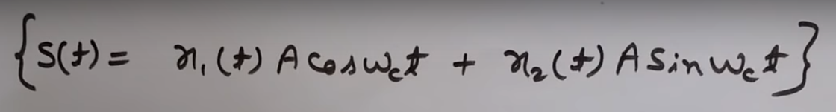

Slide 12
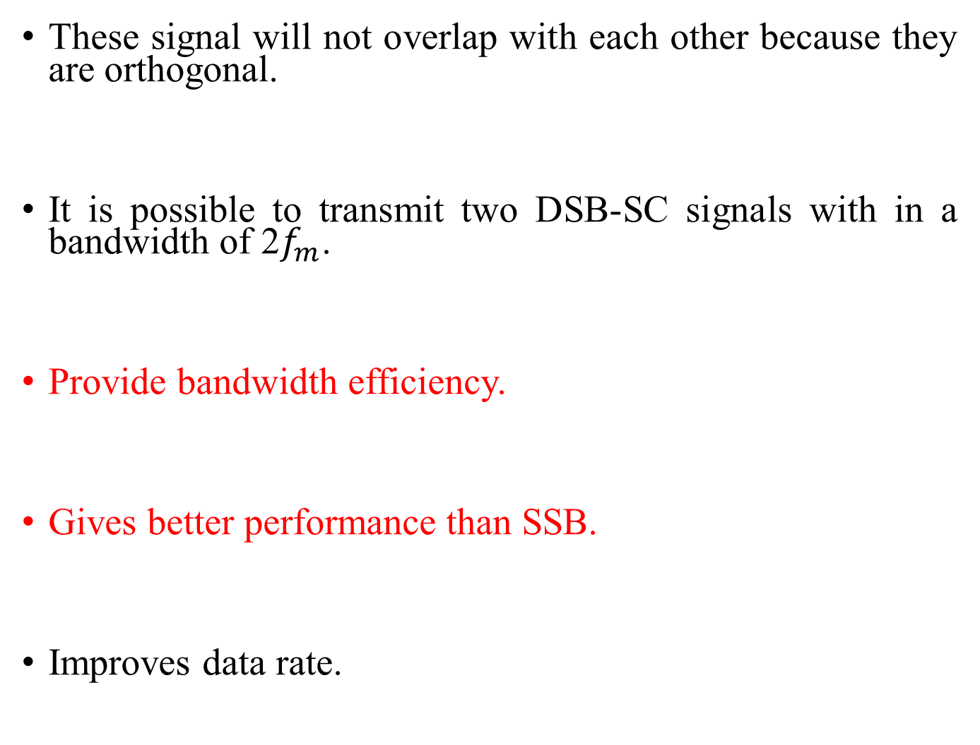
These signal will not overlap with each other because they are orthogonal.
It is possible to transmit two DSB-SC signals with in a bandwidth of 2$f_{m}$.
Provide bandwidth efficiency.
Gives better performance than SSB.
Improves data rate.

Slide 13

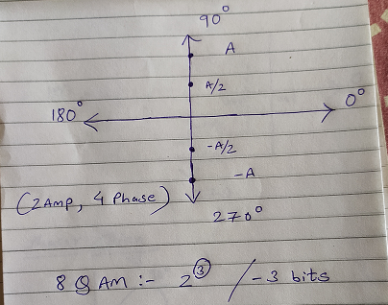
8 QAM Waveforms

Slide 14
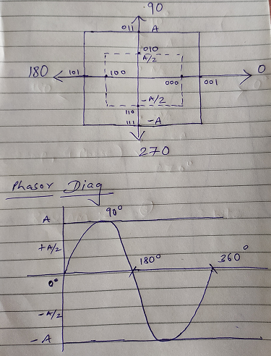

Slide 16
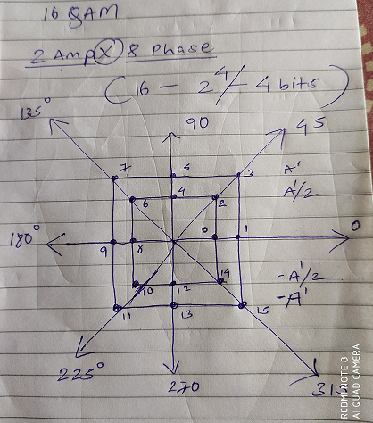
16 QAM Waveforms

Slide 17
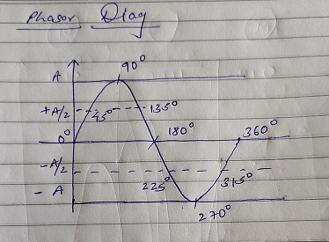

Slide 18
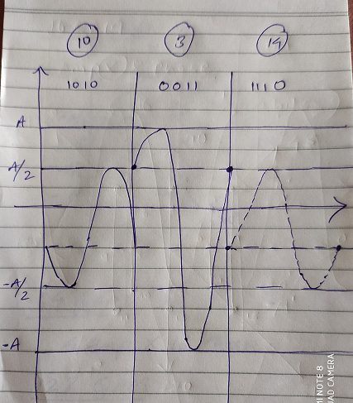
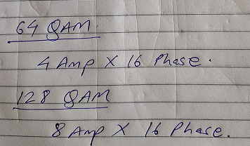

Slide 19
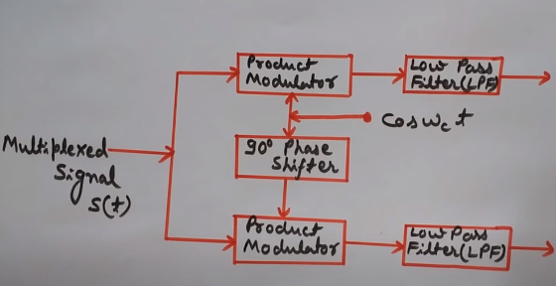
QAM Demodulation
The QAM demodulator is very much the reverse of the QAM modulator.
The signals enter the system, they are split and each side is applied to a mixer.

Slide 20
Bit Error Rate (Received Bits)
While higher order modulation rates are able to offer much faster data rates and higher levels of spectral efficiency for the radio communications system, this comes at a price.
The higher order modulation schemes are considerably less resilient to noise and interference.
Many radio communications systems now use dynamic adaptive modulation techniques. They sense the channel conditions and adapt the modulation scheme to obtain the highest data rate for the given conditions.
M-QAM technique provide better bit error rate performance than M-PSK modulation techniques.

Slide 21
Advantages
The advantage of using QAM is that it is a higher order form of modulation. As a result it is able to carry more bits of information per symbol.
By selecting a higher order format of QAM, the data rate of a link can be increased.
Bit rate is increased without increasing the bandwidth

Slide 22
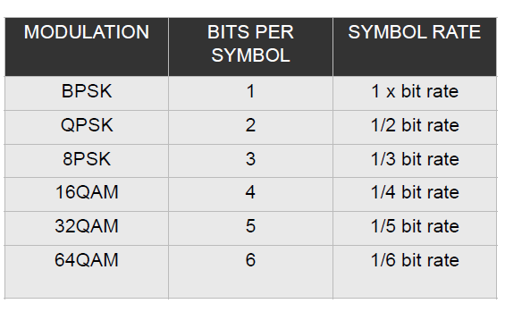

Slide 23
Applications
Quadrature multiplexing is used in color television to multiplex the so-called chrominance signals which carry the information about colors.
QAM Scheme is used on telephone lines for data transmission.
Ultra-high capacity Microwave Backhaul Systems also use 1024-QAM.

Slide 24
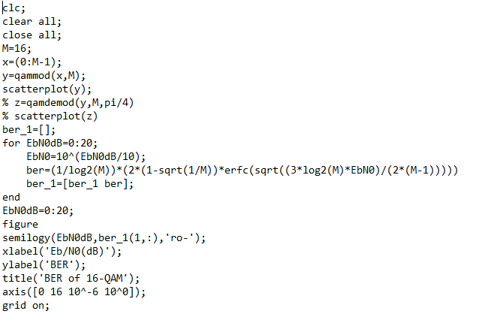
Matlab Code

Slide 25
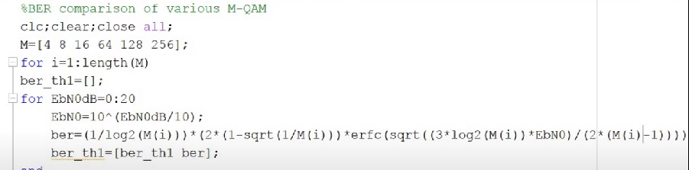
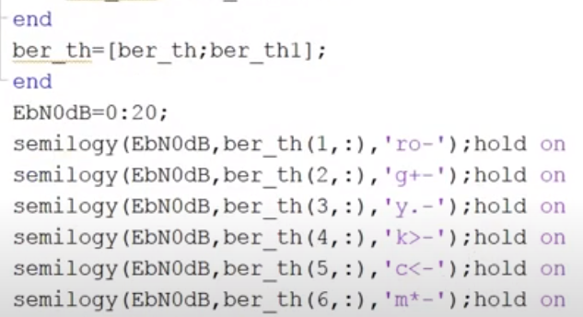
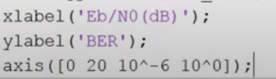

Slide 26
